Slide 1
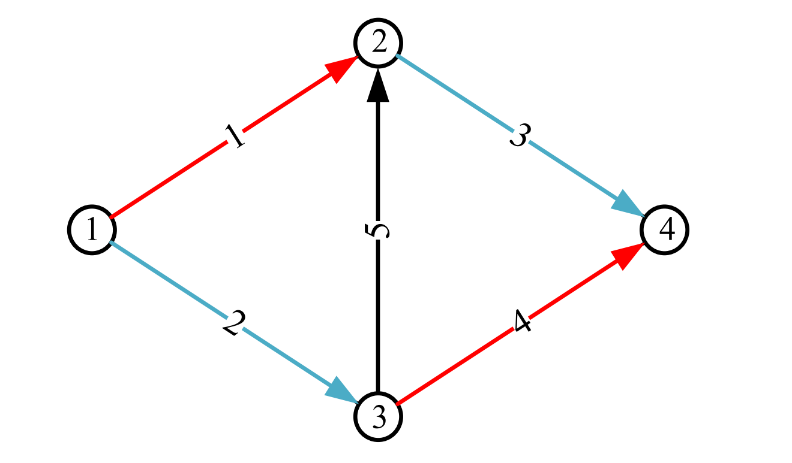

Link 1
colorPtr | counts
red | 0
blue | 0
black | 0
Link 3
colorPtr | counts
black | 0
blue | 1
red | 1
red
black
black
blue
Link 5
colorPtr | counts
black | 0
red | 2
blue | 2
Link 5
colorPtr | counts
black | 1
red | 1
blue | 2
Link 5
colorPtr | counts
black | 1
blue | 1
red | 2
red
black
Link 4
colorPtr | counts
black | 1
blue | 1
red | 1
Link 4
colorPtr | counts
black | 0
red | 1
blue | 2
Link 2
colorPtr | counts
blue | 0
black | 0
red | 1
blue

